Slide 1
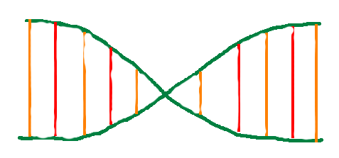
Darwin’s Nightmare
By Jonathan “Jake” Byman (jsb396), Michael Wagner (msw269)

Slide 2
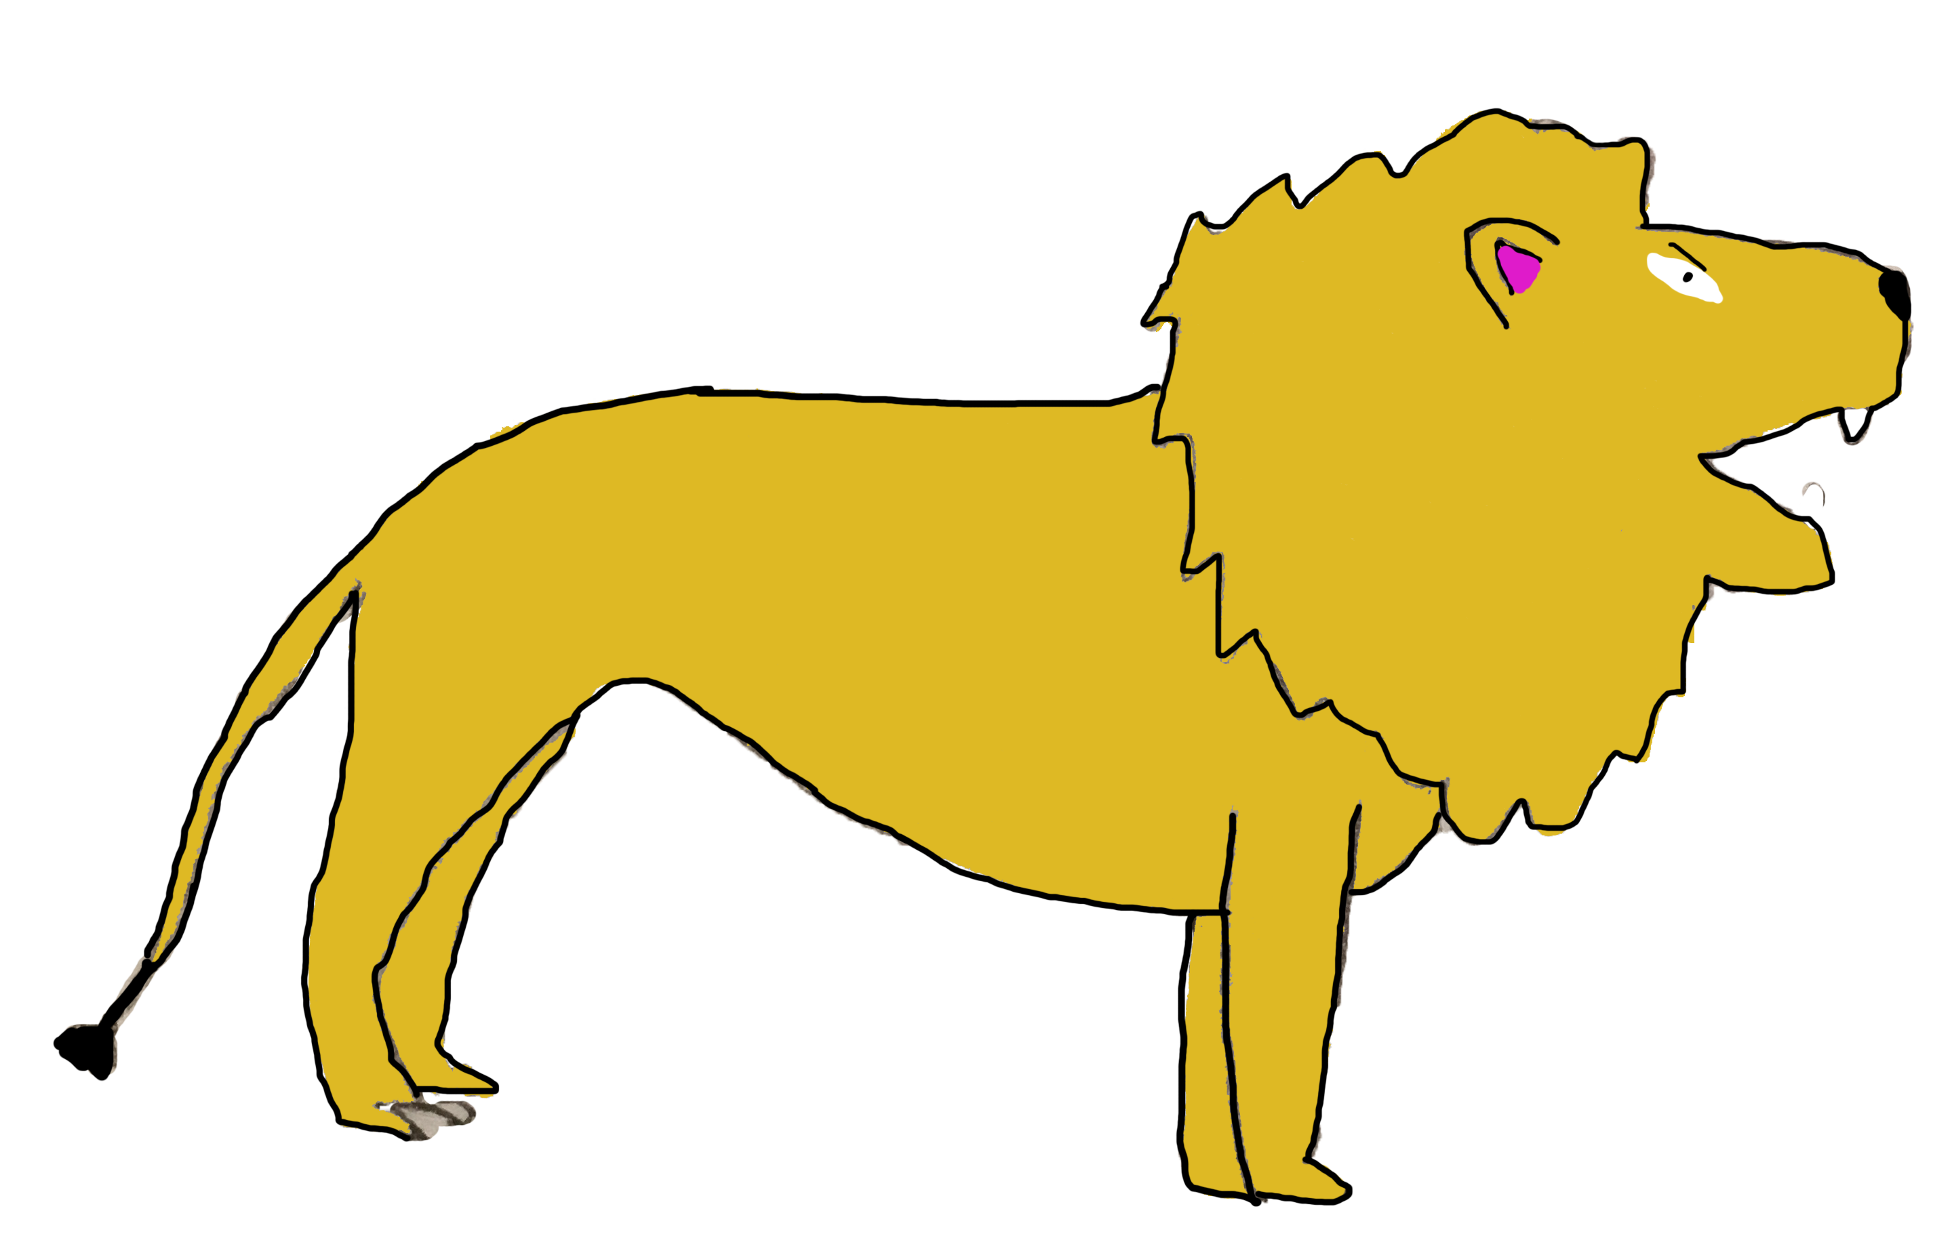
Proposal
To create a game that simulates the natural behavior of evolution
DNA is currency to evolve
Creatures become more smart
Using a QuadTree data structure
Swift: Mac OS

Slide 3
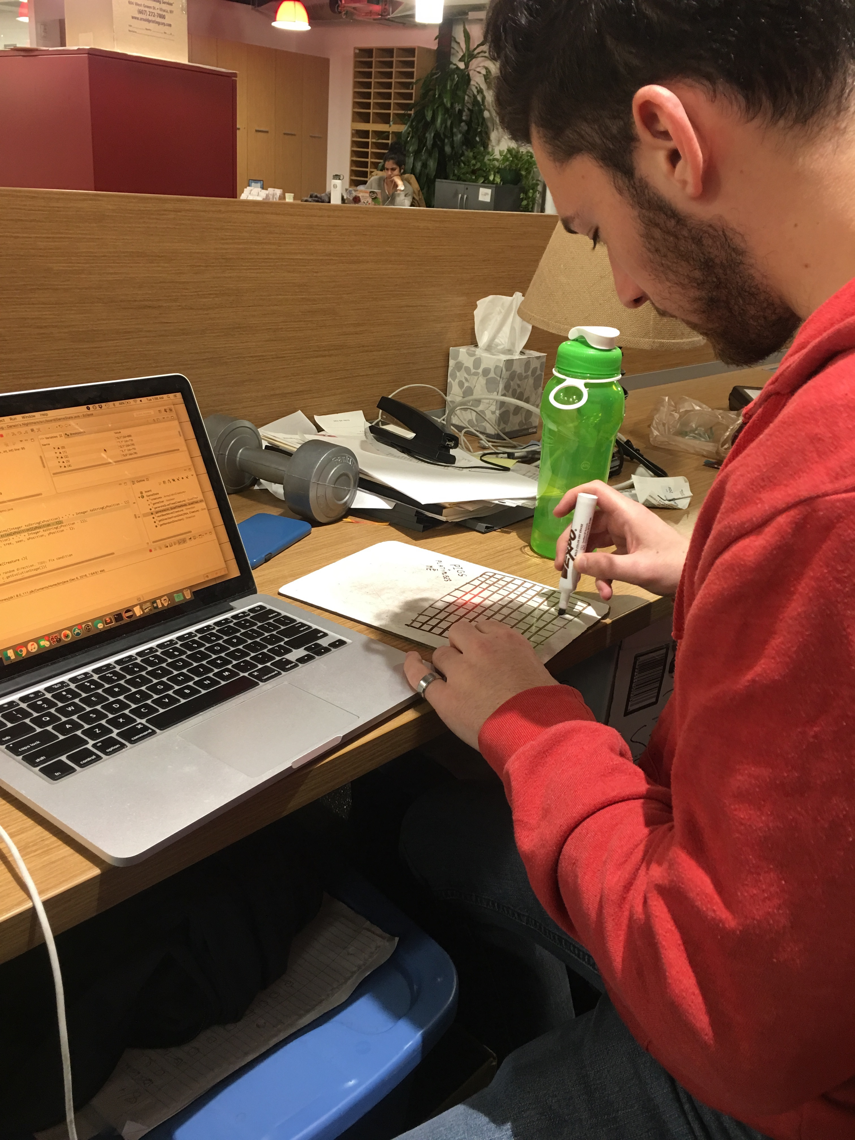
Development
Experience working together
Modified BFS
Drawing on whiteboards

Slide 4
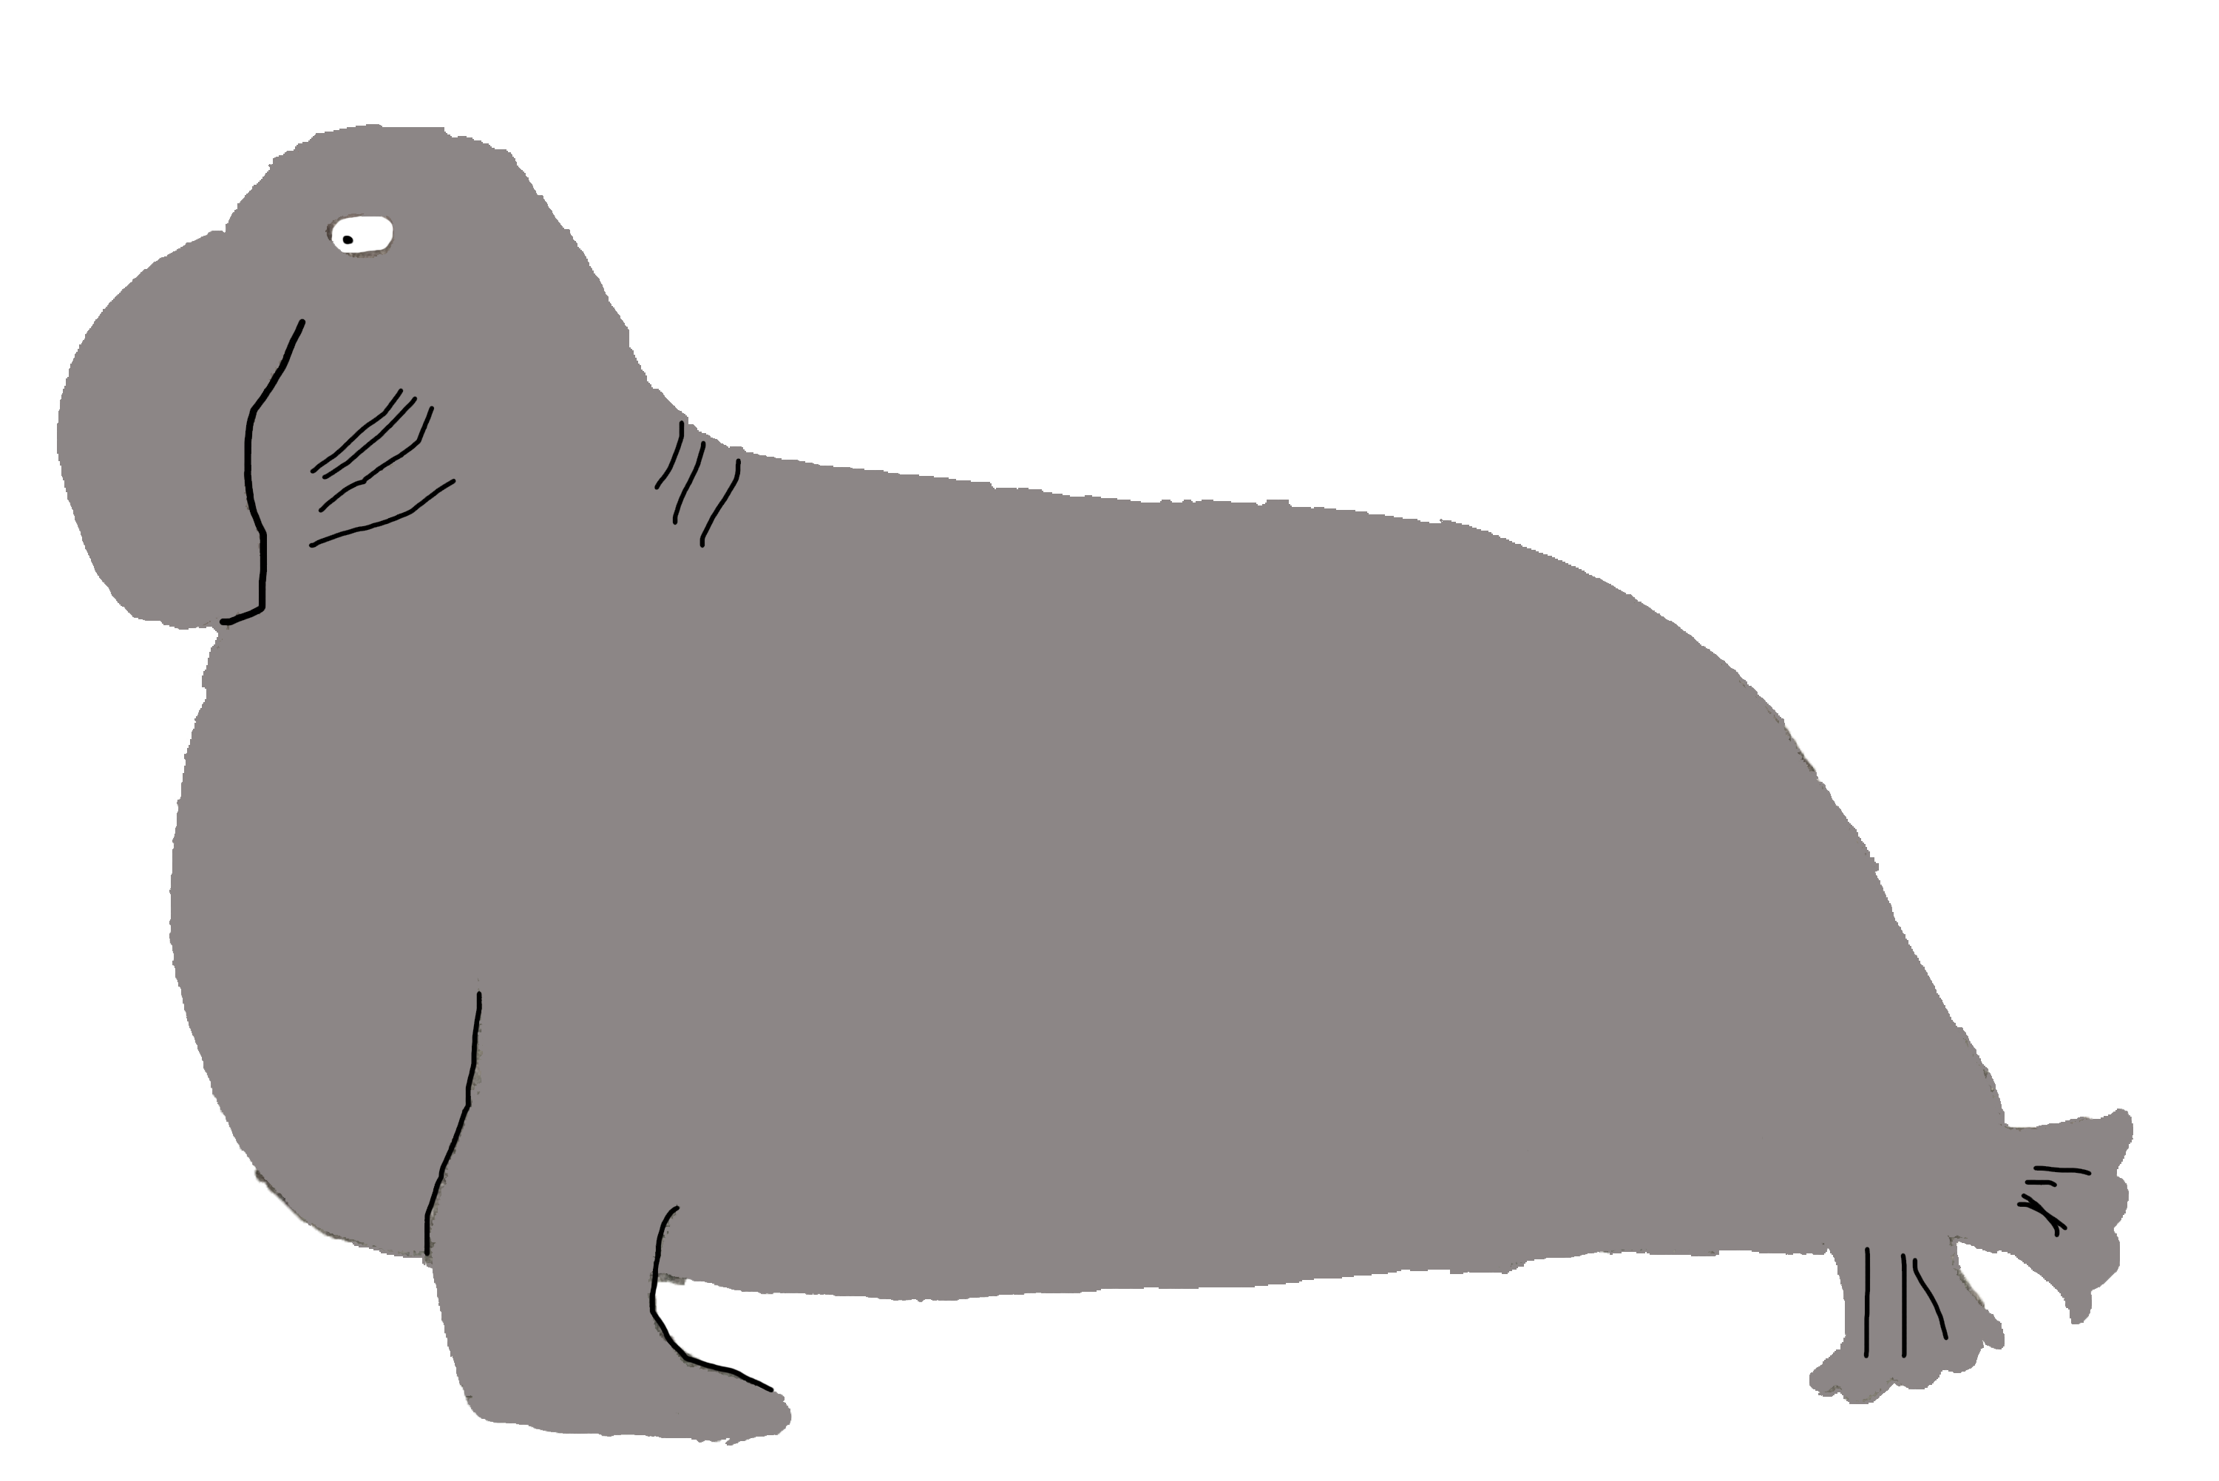
challenges
Creating QuadTree too memory intensive
Memory still tricky
Graph was much better
JavaFX a little tricky!

Slide 5
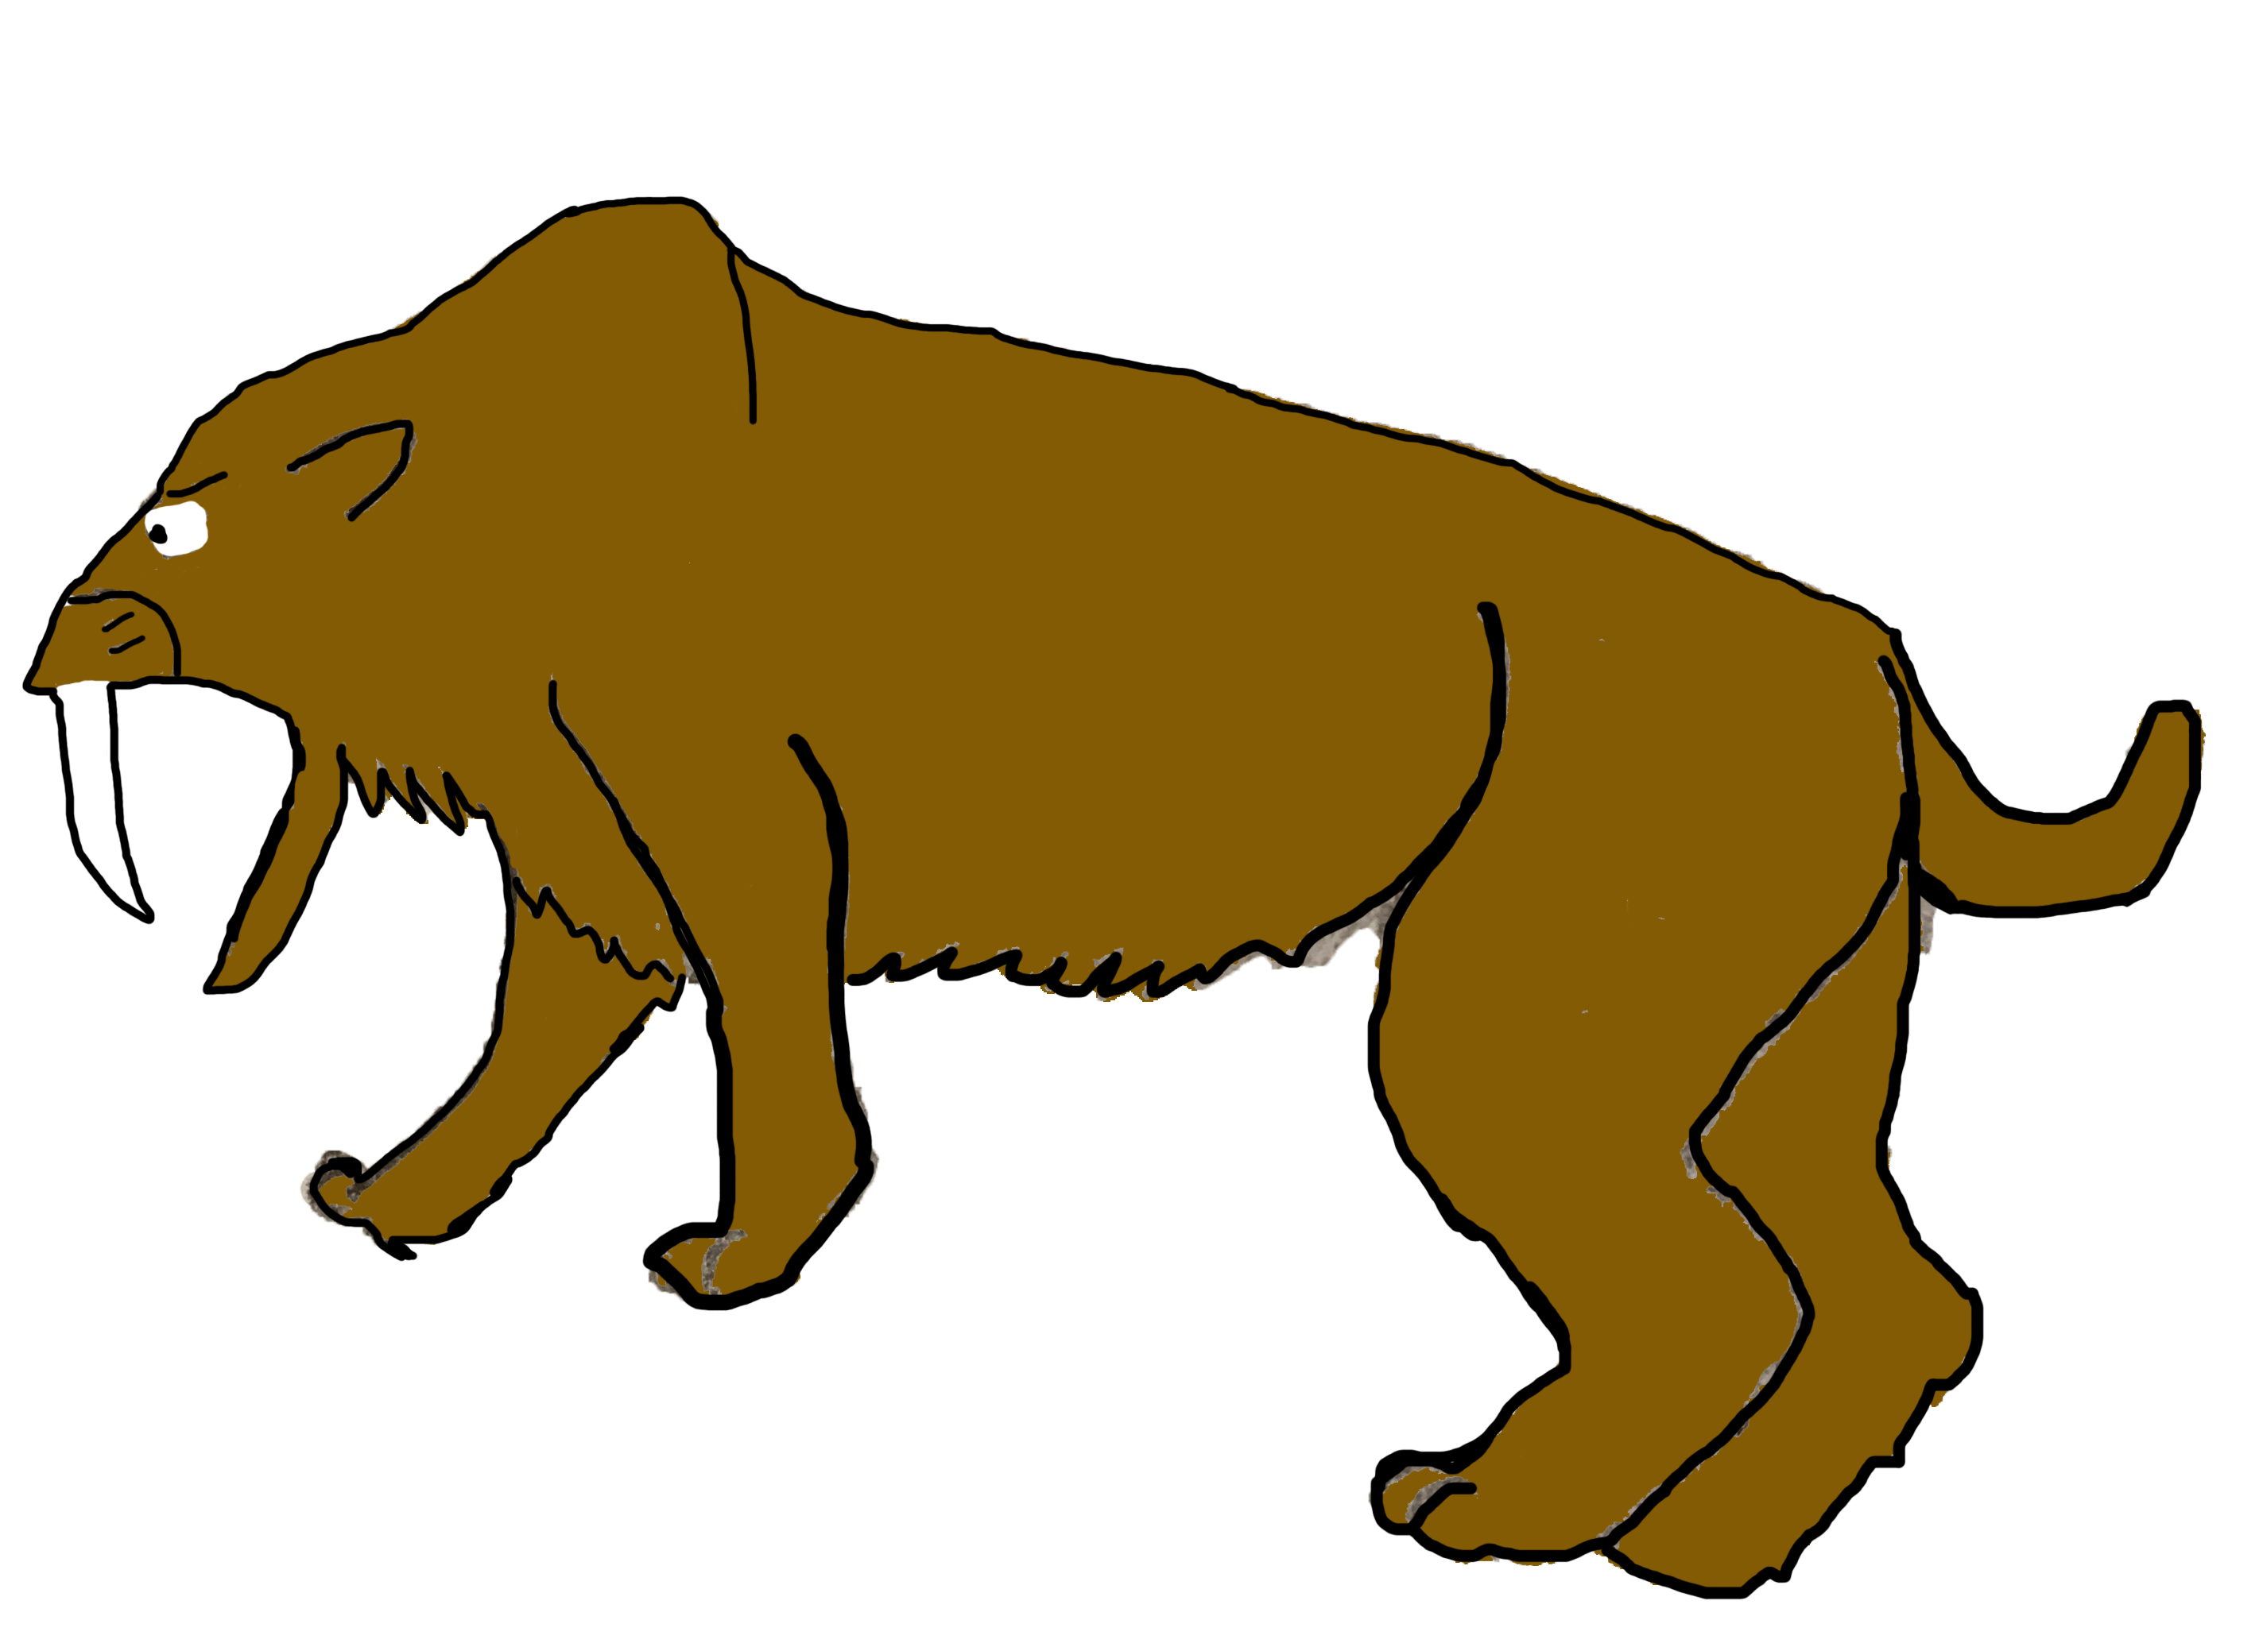
Product
Not quite a game
JavaFX
Emphasis on simulation
Using Graph data structure

Slide 6
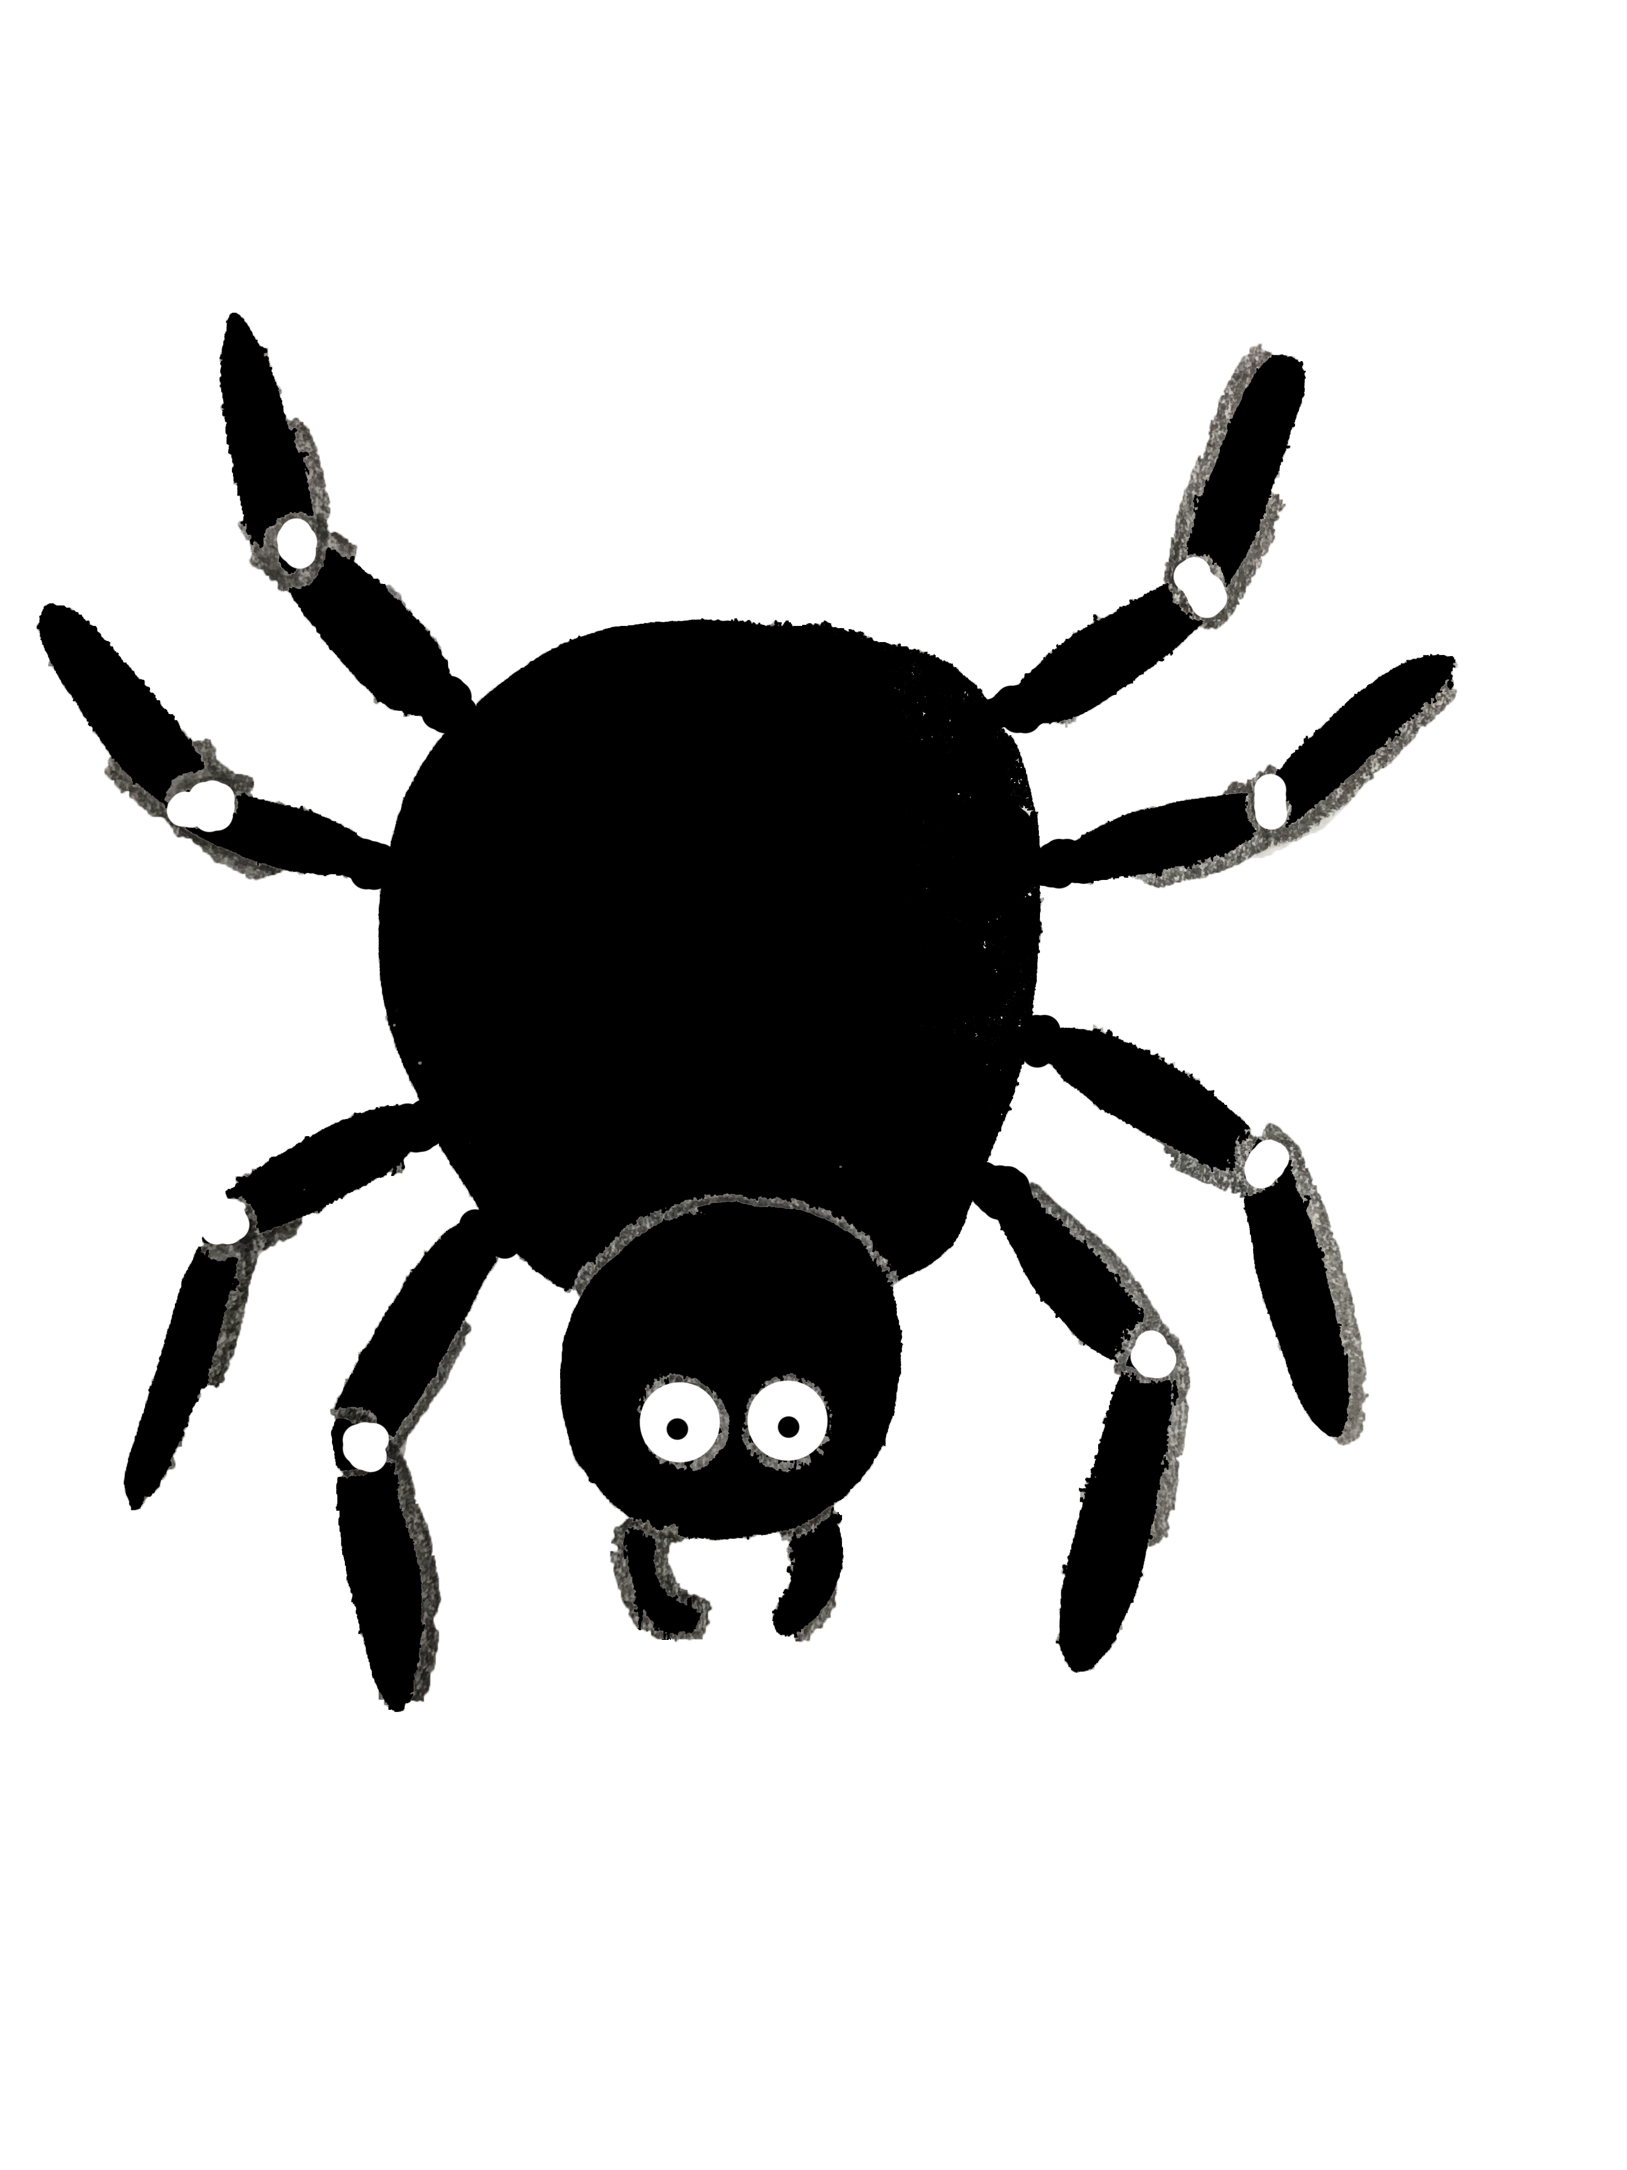
Lines of evolution
Not evolutionarily accurate! (Spider -> Spider monkey)

Slide 7
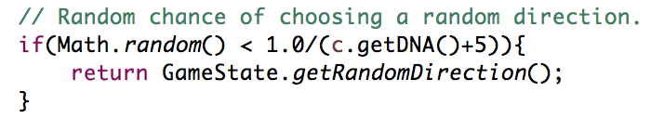
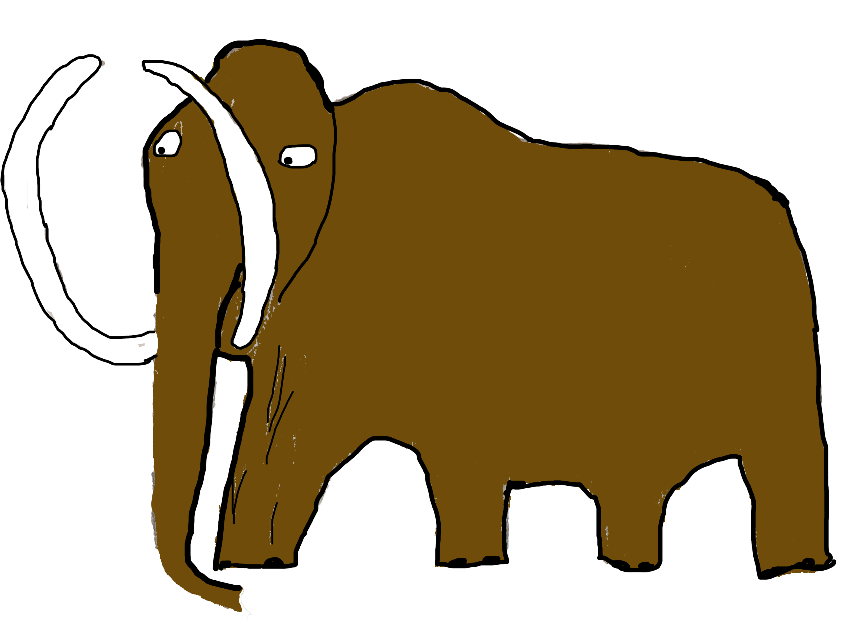
Metrics
How often does a creature become an “Apex Predator”?
Can creatures become too intelligent too quickly?
Randomness factor
BFS vs DFS?

Slide 8
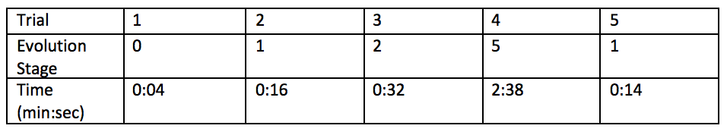

Results
With Breadth-First Search, and 20% chance of new creatures at each step, the original creature generally did not last very long
When the chance was lowered to 10%, the original creature faired much better

Slide 9
Demo
Disclaimer: We are not graphic designers
Sound on!

Slide 10
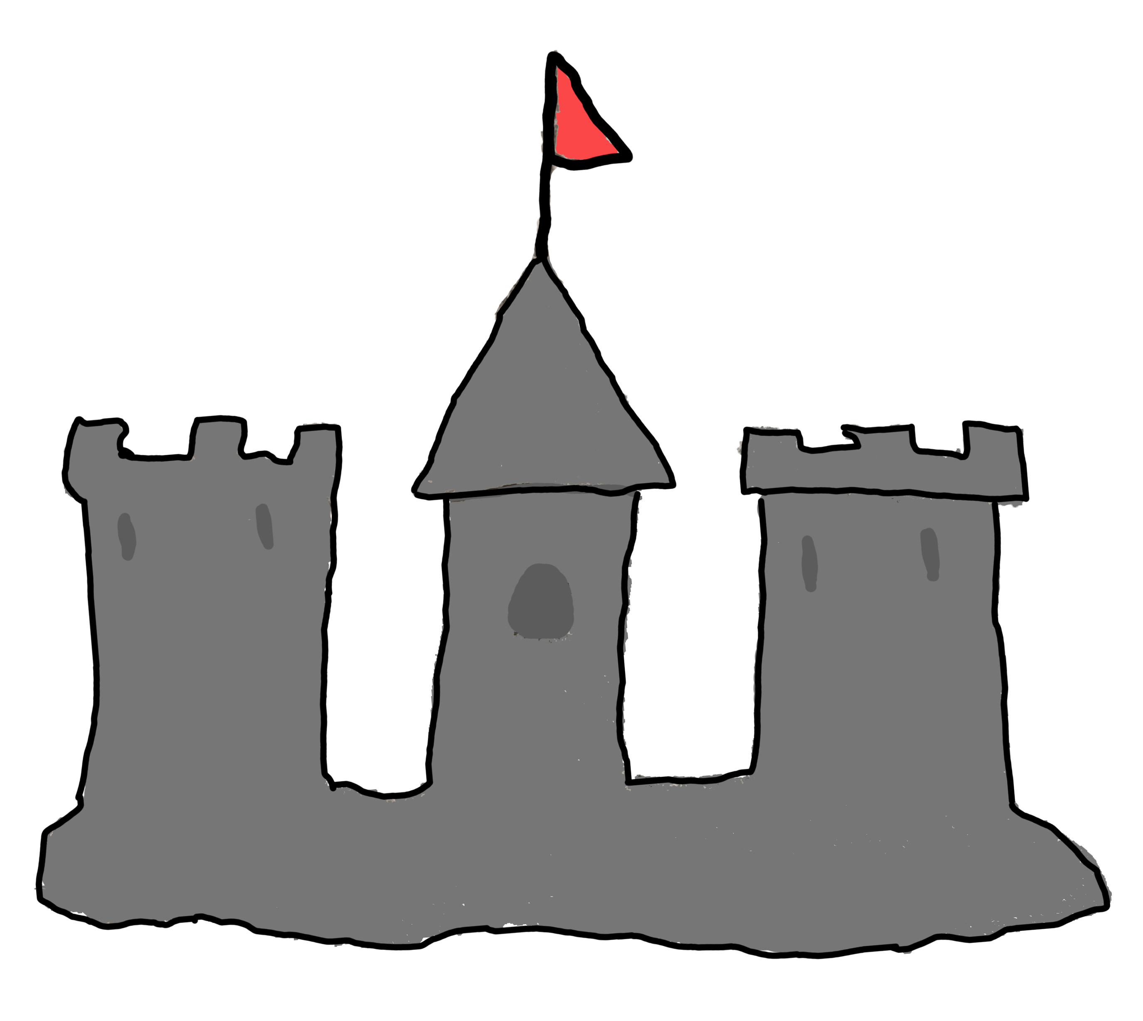
Future
To improve upon our project, we would use more search algorithms, incorporate genetic algorithms, and add a player

Slide 11
Thank you!

